Slide 1
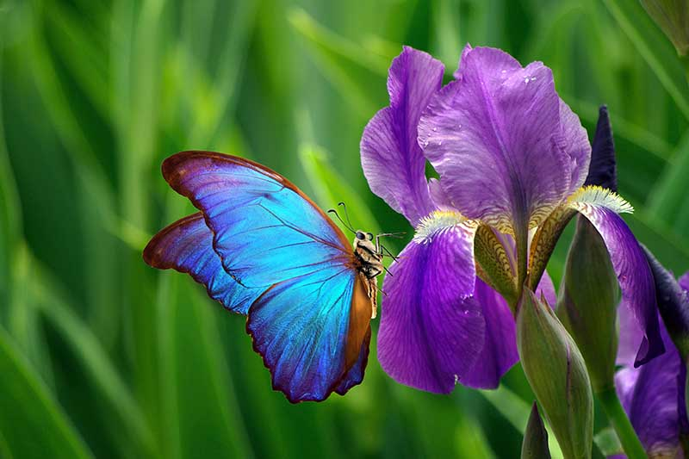

Machine Learning Classification Problem
Iris Data Set
Presented By:
Yash Kohad

Slide 2
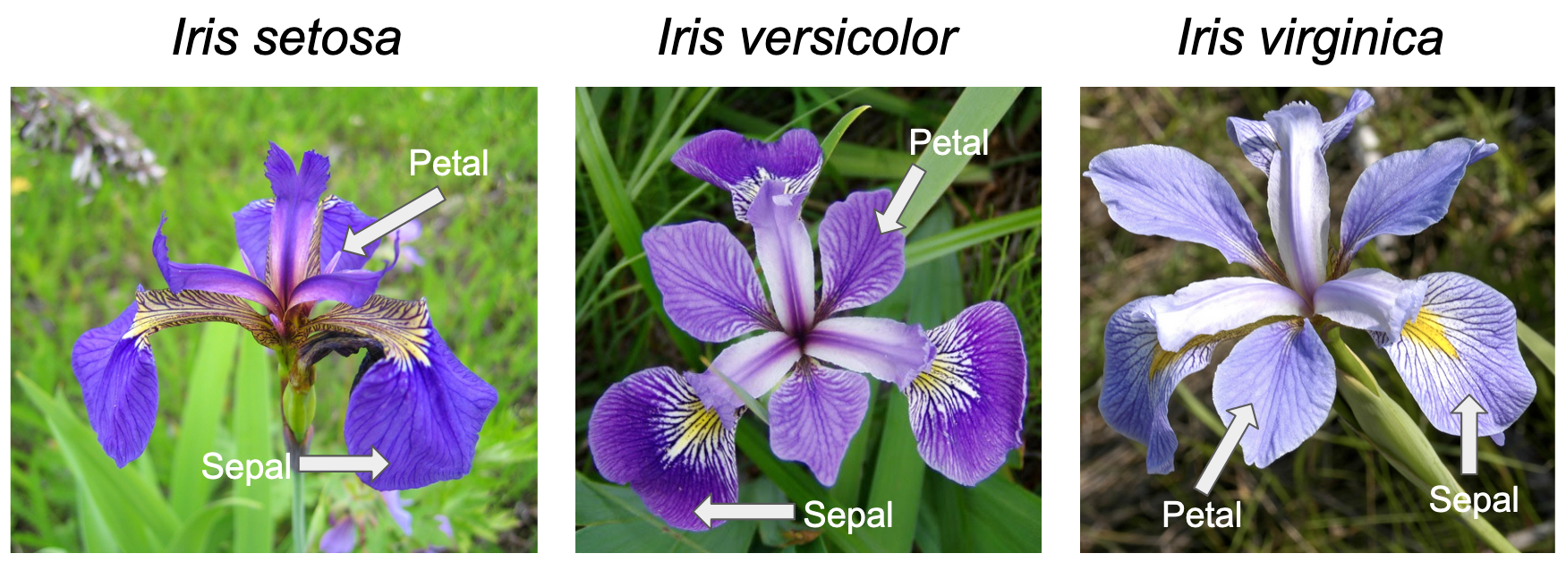
Introduction to Dataset and Problem
Column Name | Description
Id | Unique Id of each observation
Sepal length in cm | Length of the Sepal
Sepal width in cm | Width of the Sepal
Petal length in cm | Length of the Petal
Petal width in cm | Width of the Petal
Species | Species of the flower
Iris flower can be divided into 3 species as per the length and width of their Sepals and Petals:
1) Iris Setosa 2) Iris Versicolour 3) Iris Virginica

Slide 3
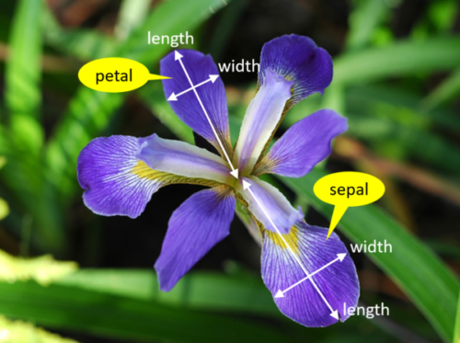
Data Set Analysis And Cleaning
150 observations (50 of each class)
ID column Dropped
4 Continuous features and one Categorical feature
No Null or missing values found

Slide 4
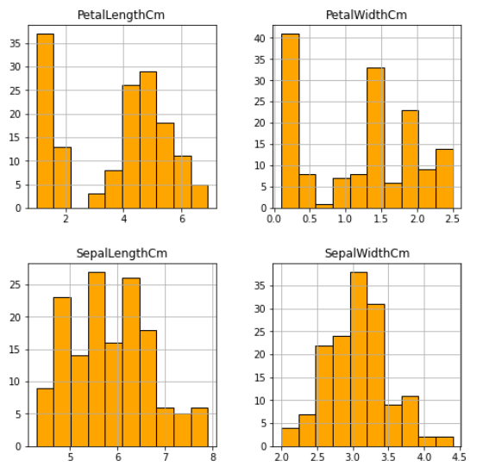
Exploratory Data Analysis
Histograms to show
distribution of flowers as per length and width of Sepal and Petal

Slide 5
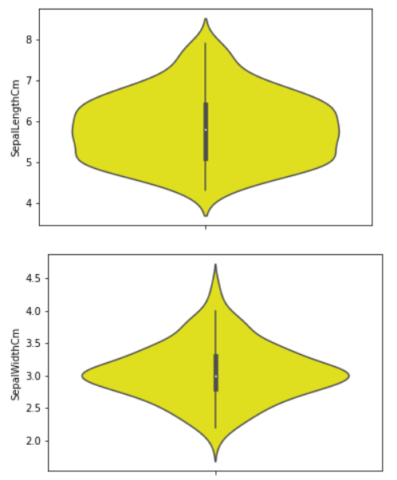
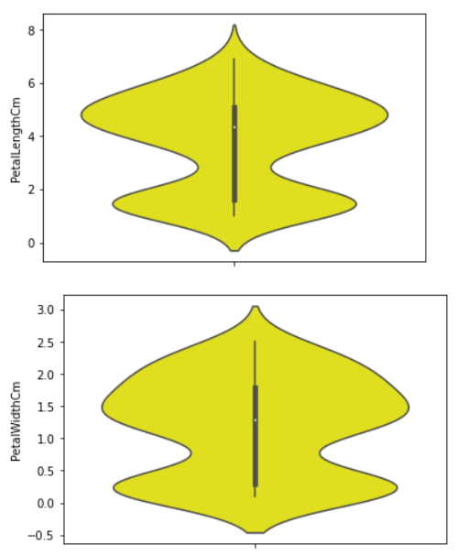
Exploratory Data Analysis Contd…
Violin plots to show the probability density of the data at different values, usually smoothed by a kernel density estimator.

Slide 6
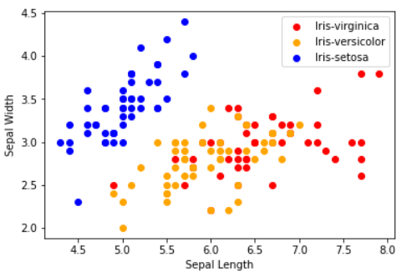
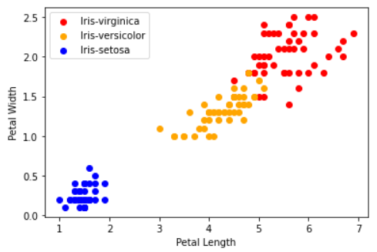
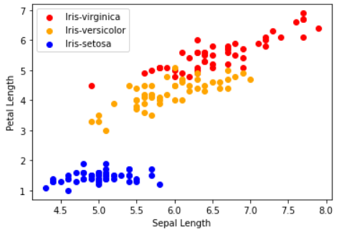
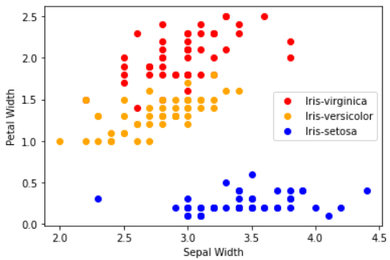
Exploratory Data Analysis Contd…
Scatter plots to show the distribution of data points across the two features at a time.

Slide 7
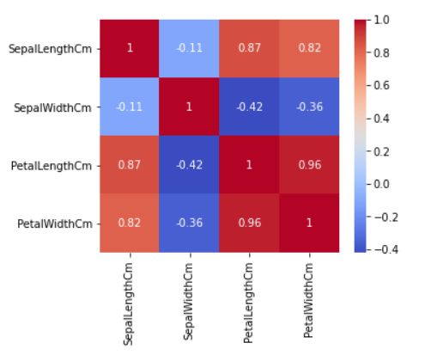
Exploratory Data Analysis Contd…
Heatmap depicting the correlation between the features with different colour shades as per the correlation values

Slide 8
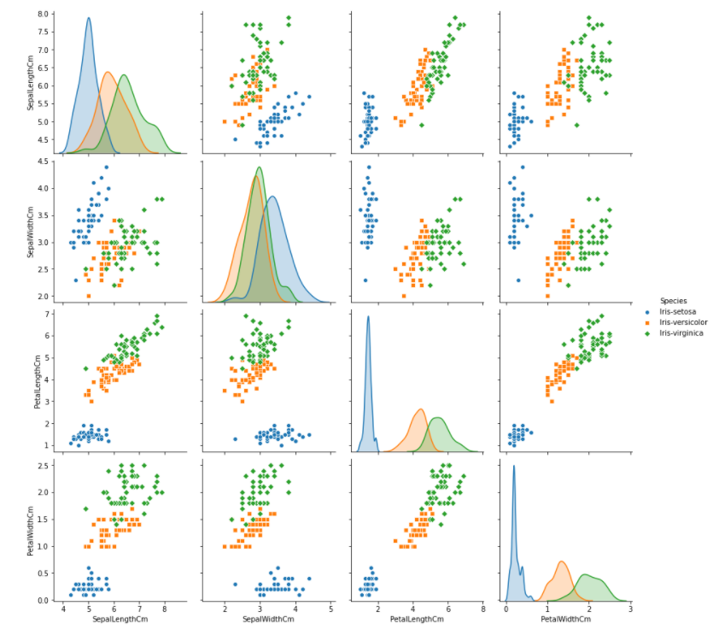
Exploratory Data Analysis Contd…
Pair Plot is a combination of the scatter plot and PDF (Probability Density Function) - the smoothened form of histogram.

Slide 9
Getting Ready for Models Creation
Label Encoding for categorical variable.
LabelEncoder()
Train - Test split of dataset
80-20 split
Data Scaling for X-Train and X-Test
StandardScaler()

Slide 10
Model Creation
Logistic Regression
log_model = LogisticRegression(penalty='l2',C=2)
K-Nearest Neighbours
knn_model = KNeighborsClassifier(n_neighbors=3, weights='distance', algorithm='auto')
Decision Tree
SVM with Polynomial Kernel
SVM with Linear Kernel
svm_model2=SVC(C=500, kernel='linear',degree=3)
dtr_model = DecisionTreeClassifier(criterion='entropy',splitter='random',max_depth=6)
svm_model1=SVC(C=500, kernel='poly',degree=3)

Slide 11
Model Evaluation Results
K-Nearest Neighbours
Accuracy Score : 100
Decision Tree
Accuracy Score : 96.67
SVM with Polynomial Kernel
Accuracy Score : 96.67
SVM with Linear Kernel
Accuracy Score : 100
Logistic Regression
Accuracy Score : 96.67

Slide 12
Conclusions
Our Iris dataset was not very large and consisted of only 150 rows, with all the 3 species uniformly distributed.
Petal Length was highly correlated with Sepal Length and Petal width.
We tried with 5 different machine learning Classification models on the Iris Test data set to classify the flower into it's three species based on the length and width of the flower's Petals and Sepals.
With some hyper parameter tuning we got a very high accuracy score for all the models, and even the accuracy score of 100 for ‘KNN’ and ‘SVM with Linear Kernel’ models.

Slide 13
Thank You

